Slide 1
Data Direct, Saudi Arabia
Capabilities presentation
Notes:
© Copyright Showeet.com – Free PowerPoint Templates

Slide 2
Your Digital Business Partner
Notes:
© Copyright Showeet.com – Free PowerPoint Templates

Slide 3
Data Direct Saudi Arabia
Organization
Established in 2015 as a Limited Liability Company (LLC)
Mansour Al Othaimin, Founder & Owner
Saudi offices
Al Rawdhah, Jeddah
Olaya Street, Riyadh
Presence
UAE, Oman, Nigeria & Sri Lanka
HQ: Dubai, UAE
Over 500 employees
Servicing clients across
GCC, Levant, Asia & Africa
Industry Presence
Banking, Insurance, Retail, Hospitality, Automobile, Real estate, Information Technology & Government

Slide 4
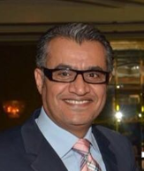
Mansour Al Othaimin, Founder & Owner
Over 30 years experience in banking, real estate and consultancy.
Contributed in creating and managing Emaar’s most iconic projects in UAE.
Launched projects around North Africa, North America, GCC & the Levant as Executive Director of Emaar International.
Playing a key role in Dalla el Baraka group, Mansour was part of the first development in GCC “Durrat Al Arus”.

Slide 5
SERVICE LINES
CC
ITS
CRM
Digital
Contact center
IT services & solutions
Loyalty services
Mobile & web
24/7 operations, Inbound & Outbound Service, Telesales & customer services, Multiple languages support
Enterprise Content Mgmt., Business Process Mgmt., Document Imagine, Asset Tagging, IT Outsourcing & Acquisition, Dashboard solution, BI, E sign, GRC, Mobile security
Customer engagement strategy, loyalty program design, Program health check evaluation, Optimizing ROI, Loyalty/ CRM services
Mobile advertising, High end Web site & mobile app, engagement bot, in-store traffic flow
Notes:
© Copyright Showeet.com – Free PowerPoint Templates

Slide 6
Contact center
Notes:
© Copyright Showeet.com – Free PowerPoint Templates

Slide 7
Key offering
01
04
Telesales
Customer support
Generating a sale & closing it as well telephone/online.
Inbound & Outbound support processes
02
05
Demand Generation
Customer Profiling
Qualifying a lead & passing to Channel/ Sales team
Enhance profile via calling
03
06
Market Surveys
RSVP
CATI led & basic surveys
Typically events
Notes:
© Copyright Showeet.com – Free PowerPoint Templates

Slide 8
Information management service
Notes:
© Copyright Showeet.com – Free PowerPoint Templates

Slide 9
Enterprise content management ( ECM)
Ensure Compliance
Charting & Reporting Tools
Helps maintain order when structure becomes too big
Enterprise content management
Workflow & Process Automation
Provides Structure out of chaos
Core features
Role Based User Portals
Enable Document anywhere
Federated Identity for Enterprise
Notes:
© Copyright Showeet.com – Free PowerPoint Templates

Slide 10
Business Process Management

Enables companies to model, deploy and manage mission-critical business processes
Span multiple enterprise applications, corporate departments, and business partners.
Cost efficiencies, agility, compliance and better customer service.
Continuously improve business processes.
Reduces time-to-market for changes in business processes.

Account Opening and Maintenance
Account Payable
Call Detail Record Management
Trade finance
Features
Key solutions
Notes:
© Copyright Showeet.com – Free PowerPoint Templates

Slide 11
Contd.
DOCUMENT IMAGING
Converting physical documents into digital form
ASSET MANAGEMENT
Asset management software
Asset lifecycle management
Asset Audit
Asset register buildup

Slide 12
IT Solutions
Notes:
© Copyright Showeet.com – Free PowerPoint Templates

Slide 13
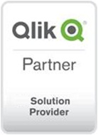
IT Solutions
1
Business Intelligence
E signature
IT services
3
2
Services across BI, GRC, E Sign & Mobile security solutions & adding more
GRC
Mobile security
4
Notes:
© Copyright Showeet.com – Free PowerPoint Templates

Slide 14
Business Intelligence
Qlik
Microstrategy
BI Software
Enterprise Analytics Platform
Qlik delivers Business Intelligence software for data visualization, guided analytics, embedded analytics and reporting to over 40000 customers worldwide
MicroStrategy is an easy-to-use enterprise analytics platform that delivers dashboards, visualizations, mobile apps, and more to thousands

Slide 15
MetricStream, comprehensive GRC solution
Policy & Document Management
IT Risk Management
GRC Intelligence ® Content
Enterprise Risk Management
IT Compliance
Operational Risk Management
Threat & Vulnerability
Language Pac
Vendor Risk Management
Integrations
SOX Compliance
Compliance Management
Business Continuity Management
Reg. Change Management
Supplier Quality Audit
Internal Audit
Inspections Management
Operational Audit
NCM & CAPA Management
Case Management
Incident Management
Training & Advisory
Mobile
Third-party Management
Conflict Minerals Management

Slide 16
Zimperium, mobile security solution
Investors
Funded by Warburg Pincus, Sierra Ventures, Telstra and Oxygen
Mobile Security
01
02
03
04
05
Awards
Revolutionary enterprise mobile security solution.
2016 Most Innovative Cyber Security Company – CEA
2016 Best in Breed for Mobile Endpoint -- CDM
2016 Most Disruptive Technology – Telecom Council
2015 Awesome Product of the Year – Info Security
2015 Best of the Show Award – InterOp
2013 Start-up of the year -- KPMG
The solution
Leadership
Behavioral analytics threat detection engine, based on machine learning algorithms, transforms mobile devices from a threat to an advantage
Leading mobile security researchers. Established the ZHA comprised of 30+ leading MNOs, OEMs, App Developers
.
Notes:
© Copyright Showeet.com – Free PowerPoint Templates

Slide 17
CRM
Notes:
© Copyright Showeet.com – Free PowerPoint Templates

Slide 18
Services
Customer Engagement
Loyalty/CRM RFP
Overall strategy, customer value proposition development, customer experience design & implementation, customer comm., customer journeys & treatment tracks
Assessment of requirements, development of brief, selection of supplier long list, support engagement of RFP process
Loyalty Program Design
Partnership Development
Core strategy, customer value proposition, communications, operational set up, costing & ROI analysis, system selection, recruitment & training
Development of partner propositions, recruitment of reward partners, third party points sale, Partner offers & services, recruitment & contacting
Program Health Check
Optimizing ROI
Operational efficiency, communications effectiveness, investment review, analysis of ROI, program enhancement proposal, team training & mentoring
Costing review, rewards investment and perceived customer value vs. cost, demonstrating reduced churn, and increased share of customer.
Notes:
© Copyright Showeet.com – Free PowerPoint Templates

Slide 19
Industry experience
Retail
Airlines
Loyalty program design for opticians, pharmacy, department stores, jewelers, toy stores, fashion
Customer communication strategies Technology selection, participation in coalition evaluation.
FFP design, LCC design strategies, partner recruitment & point sales.
08
01
Finance
Restaurants
Credit card loyalty program, design and implementation, health check optimization, bank program design, reward partner recruitment, communications planning & ROI effectiveness analysis.
02
Casual & fine dining, program design technology selection
07
Insurance
03
Hospitality
Churn reduction strategies, customer engagement activity, cross selling customer journeys.
06
Strategic design for hospitality groups, hotel program health check
05
04
Packaged goods
Entertainment
Rewards for purchase strategies, promotional concept development, digital engagement activity
Shopping mall leisure facilities program design, family leisure centers customer engagement strategies.
Notes:
© Copyright Showeet.com – Free PowerPoint Templates

Slide 20
Digital Marketing
Notes:
© Copyright Showeet.com – Free PowerPoint Templates

Slide 21
Possibilities
Engagement Bot
Bot
Building engagement in-store
Smart video analytics solution
Video Analytics
A smart video analytics solution that provides insights around in-store shopper traffic pattern.
In-app mobile advertising
Mobile advertising
We have a platform that can deliver advertising in-app within a particular geo location layering with other filters.
Notes:
© Copyright Showeet.com – Free PowerPoint Templates

Slide 22
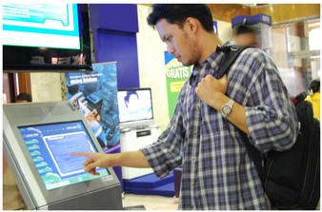
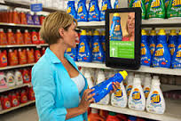
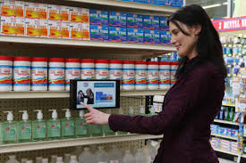
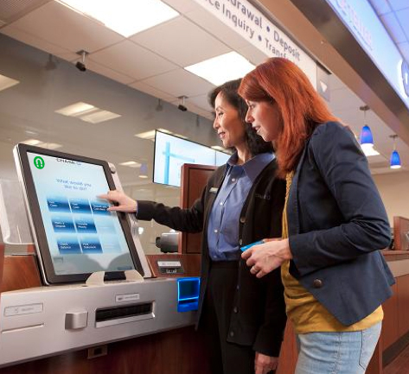
Building engagement at the store using bots
Increase Loyalty Sign-ups
Influence Buying decisions in Real-time
Personalized information based on Customer Choices
Collect and Measure
Feedback instantly

Slide 23
Contd.
Effective store management
Campaign across categories
Call To action Communication, along with Branding content
.
Target focused campaigns
Quickly setup a Campaign
Reach Qualitative TG
Track the engagement
.
Real time insights
Compare effectiveness of communication in different category
Live Dashboard
In store analytics
Notes:
© Copyright Showeet.com – Free PowerPoint Templates

Slide 24
Smart video analytics solution
# Brick & Mortar will have to understand shopping behavior to compete with online
…and helps track intelligent KPIs that go beyond conversions

Slide 25
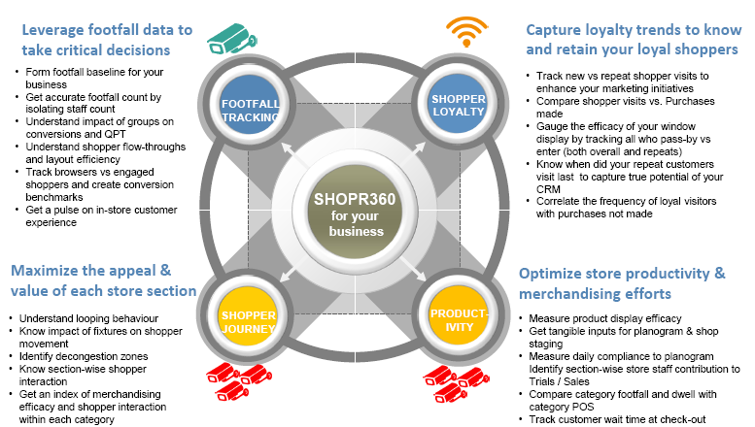
Translates store traffic patterns into tangible business decisions

Slide 26
In–app mobile advertising
1
2
3
Geo location
Age profile
Gender
specific point, street, city, region, country
Age profile bands
Male or female
4
5
6
Keyboard language
Category of apps.
OS & Type of device
English, Arabic
Games / education / tourism / sports / business / fashion
iOS, Android, Windows
We have a platform that can deliver in-app advertising on mobile devices using different parameters within a particular geo location
Notes:
© Copyright Showeet.com – Free PowerPoint Templates

Slide 27
Other services
21,62,162
01
Chat bots
AI/IOT
02
03
VR
04
High end Website
05
Regular web services
Notes:
© Copyright Showeet.com – Free PowerPoint Templates

Slide 28
8. Marketing Services
Offline marketing
Notes:
© Copyright Showeet.com – Free PowerPoint Templates

Slide 29
Offline marketing services
BTL Activation
Branding
Exhibition
Trade Shows
In-store
Events

Slide 30
Creative services

Slide 31
Creative Services
TVC
Radio
Print
Outdoor
Radio
ATL
BTL
BTL Campaign elements
Lama
Floor standees
Services
Brochure
Newsletters
Flyers
POS
Collaterals
Digital
Banners
Mailers
Landing page
Page capture

Slide 32
KSA Business
Overview & infrastructure

Slide 33
Overview
Facilities
Riyadh on-site contact center facility with over 100 seats and management offices
Jeddah office coming up with a 5,000 sq.ft. contact center facility
Servicing clients
Inbound contact center on an integrated digital platform for Saudi Telecom
Saudi and expat work force - Arabic and Bi-lingual

Slide 34
Case study – Saudi Telecom Company
Exclusive vendor to provide Digital Engagement Advisor to Jawwy (Sapphire) a subsidiary of Saudi Telecom Company.
Mobilization:
Skill set Search
Scheduled & Managed more than 500 interviews within 30 days
Successfully hired team of 60 employees in 30 Days
Within 4 months, team has grown up to 100 employees
Operating Efficiency:
Trained the employees on customer service skills
On the job with Voice and Non Voice processes
Dedicate Process Trainer and CTI IT Support Specialists on site
Saudization:
On boarded 80% Saudi National Work Force
Provided job to Female Executive to promote Female employment
Fully Complaint with Saudization
Return On Investment to Jawwy:
Operating round the clock services to Jawwy
Successfully handled over 200,000 elite customers of Jawwy

Slide 35
Our Clients

Slide 36
Thank you
Notes:
© Copyright Showeet.com – Free PowerPoint Templates

