Slide 1
Data Direct Group
Capabilities presentation
Notes:
© Copyright Showeet.com – Free PowerPoint Templates

Slide 2
Your Digital Business Partner
Notes:
© Copyright Showeet.com – Free PowerPoint Templates

Slide 3
About Data Direct
Organization
Established in 2002 as a Limited Liability Company (LLC)
Rajiv Dalmia, Chairman and Managing Director (MIB – Australia)
300+ employees
Data Direct Group Companies
HQ: Dubai Media City, UAE.
Operations Unit in Dubai : Direct Outsourcing Services LLC - 150 workstations
Onsite contact center for client in Oman (2014) : Century Data Systems LLC – 50 workstations
On site contact center for client in KSA (2015) : Data Direct Saudi Arabia – 100 workstations
Operations Unit in Sri Lanka (2016) : Data Direct South Asia Pvt. Ltd. - 25 workstations
Presence in Nigeria (2017) : Data Swift Africa Ltd
Offshore Analytics Team from India
Our Offerings
Contact Centre Services
Loyalty program development & management
CRM and data analytics center
Online and offline fulfillment / mail room / broadcast services
Archiving Solution, Records Management, ECM and BPM technologies
Consultancy on resource time and process optimization
Implementation of cost and time effective business processes

Slide 4
Business Knowledge
Headed by successful business leaders
Excellent infrastructure with latest technology & CRM solutions such as Qlik View & Metric Stream
Quick turn around time and quality output
Strong understanding of Cross sell & Up sell campaigns to create high LTV
High level of security standard with regards to information & processes
Back up and disaster recovery for smooth business continuity
Highly skilled professional with strong domain experience
Fully trained resources of Contact Centre Managers, Team Leaders, Quality Controllers & Database Administrators with adequate experience and necessary qualification
Knowledge in handling GRC and data security as per BFSI standards
Audited and approved by BFSI companies and their sponsors.
Over 100 years of business presence in Oman & Saudi Arabia to understand market dynamics, operations, recruitment procedures, etc

Slide 5
Experience in region
Over 15 years experience servicing multinational companies, government authorities and large corporates
With more than 300+ staff, we specialize in providing long term and short term Contact Centre Services
We believe in offering jobs to the citizens of the country in Oman and Saudi Arabia
100% compliant with labour nationalisation policies in the respecitive countries
Our process-driven approach enables our company & client’s outsourced function to get started quickly and more productively
We have simplified various time-consuming tasks by automating our back office processes ranging from sourcing candidates to managing performance on behalf of our clients.
We have proved that outsourcing of contact centre services is a convenient way to transform your Sales and Services department without adding infrastructure, headcount, or cost while still be compliant with government rules & regulations
We believe in building long term relationships shared by the passion to serve your interest. Our commercial propositions match your imperatives by offering you contact centre solutions between capital spent and revenue generated per head count

Slide 6
1. Contact center
Sujit Churi, GM Operations
Notes:
© Copyright Showeet.com – Free PowerPoint Templates

Slide 7
Key offering
01
04
Telesales
Customer support
Generating a sale & closing it as well telephone/online.
Inbound & Outbound support processes
02
05
Demand Generation
Customer Profiling
Qualifying a lead & passing to Channel/ Sales team
Enhance profile via calling
03
06
Market Surveys
RSVP
CATI led & basic surveys
Typically events
Notes:
© Copyright Showeet.com – Free PowerPoint Templates

Slide 8
Contact Centre Infrastructure
Contact Center
Installed Capacity Installed capacity – 300 seats
Advanced Technology Customized CRM Live monitoring ACD/IVR Call Recording Auto Dialer (Predicative & Progressive)
Multilingual Staff English Arabic Indian Subcontinent (including Bengali, Urdu) Tagalog
Experienced Professionals Business Mgmt. Development CRM Development System Integration Quality Control

Slide 9
Training
We offers ‘Train The Trainer’ (TTT) approach to our clients
A set of individuals from our team will get trained and certified by Client’s trainers
These certified trainers then will train the subsequent batches for the program
The entire training will be divided into two parts: 1. Pre-process training 2. Process training
The pre-process training will include soft-skill, customer service, telephone etiquettes, assertiveness and objection handling.
The process training includes understanding the CRM, process work flows, SOPS, etc
Keeping in view the dynamic nature of our client’s business where changes and updates are essential to the business, we also believe to have a monthly refresher training
A training manual would be created in conjunction with inputs from Data Direct & clients which will be updated on an on-going basis
We also propose to create a list of frequently asked questions (FAQ) and store it for future training purpose

Slide 10
Contact Center - Services
Communication method - telephone, email, Chat
Inbound & Outbound calling activity to manage telesales
Sponsor data calling, open market and hot leads
Inbound enquiry handling on basis of advertised campaigns
Collect references from successful conversion to acquire new customers
Lead generation for Sales executives

Slide 11
Approach
Phase 1: Contact Centre - Ownership data of corporate companies
Managing the inbound sales calls to offer respective products
Targeting existing customer data for renewals/retention
Identify opportunities to upsell; Product Mix
Phase 2: Contact Centre - Sponsor data
Data Direct will dial on data procured by corporate companies through partnerships with Banks, Automotive or other businesses
Products can be sold based on sponsor data
Running cross sales campaign on existing customer and prospect

Slide 12
Approach…2
Phase 3: Digital Marketing – Lead Generation
Digital campaign either simultaneously with contact center or upon exhaustion of first 2 phases
Online special offers, promotional offers against fast moving products
Data acquisition of customer through telephone or online media
Call backs to customers who registered/Interested
Phase 4: Promoters Activity – Lead Generation
Putting up Kiosks at Supermarkets/shopping malls
Approach directly to customers in the mall with product info
Pre-qualification and data collection
Identification of interested and eligible products
Call back pre-qualified customer for sales conversion

Slide 13
Approach...3
Phase 5: Direct Sales Agent
Increase in product mix; high premium products
Analyze and identify potential customer on basis of data collected through sales
Analysis of best offer approach
Target customers to be called and pitch product
Qualify customers as per minimum requirements
Arrange appointments for Direct Sales agent to meet and convert

Slide 14
Business Models
Option 1
Managing operations with FTE’s and Infrastructure from the Data Direct’s office
Option 2
Managing operations with FTE’s and Infrastructure from client’s office with Data Direct Management
Option 3
Providing FTE’s at client’s offices and managed by client
Option 4
Providing infrastructure to client’s resource to operate from Data Direct’s office
* Commercials will be based on client needs & requirements

Slide 15
Contact Centre - Team Structure
Managing Director
Business Manager
Contact Centre Manager/TL
CFO
Operations Manager
DBA & IT Support
Quality Controller
Agent
Agent
Agent
Agent

Slide 16
Contact Centre Technology

Slide 17
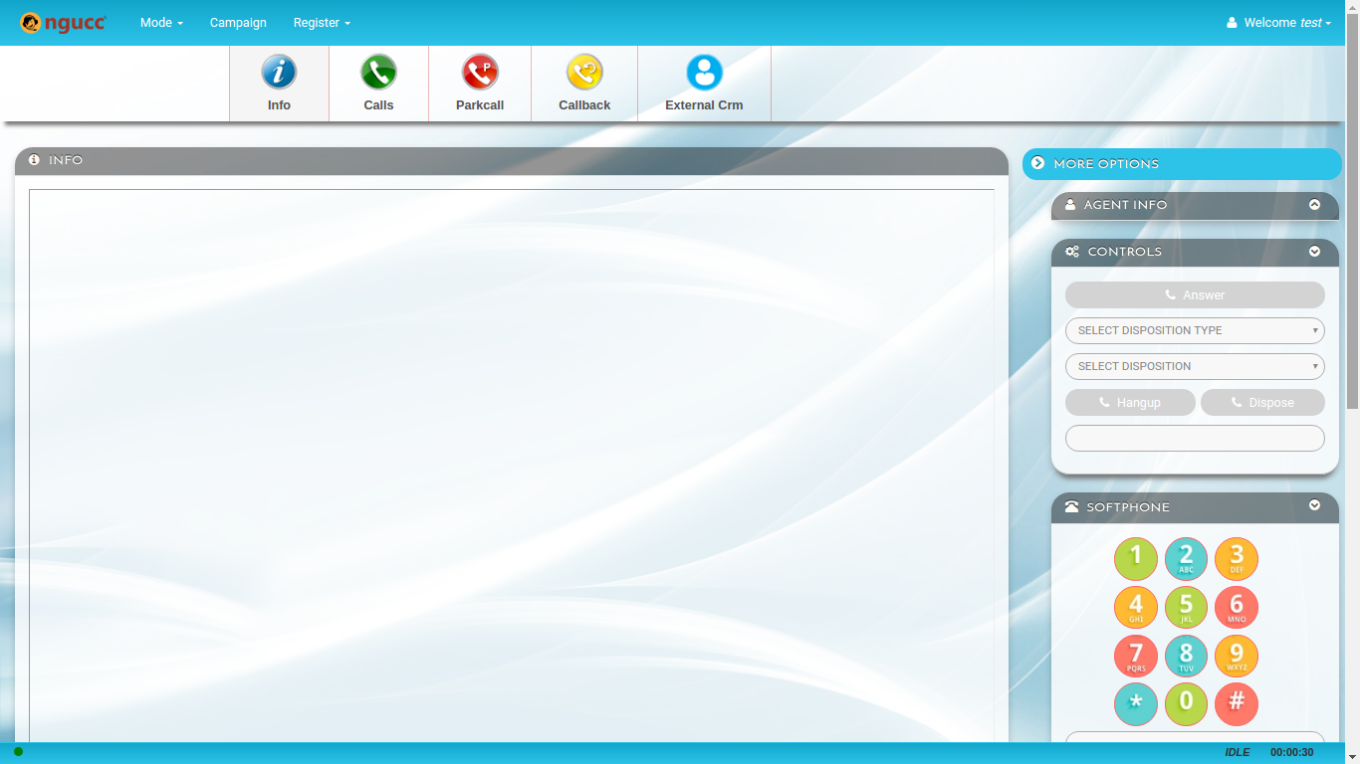
Agent Desktop

Slide 18
Supervision Tools

Slide 19
Supervision Tools

Slide 20
Dashboard

Slide 21
Daily & Monthly Reporting

Slide 22
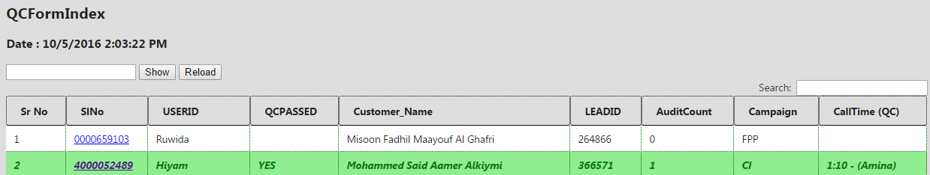
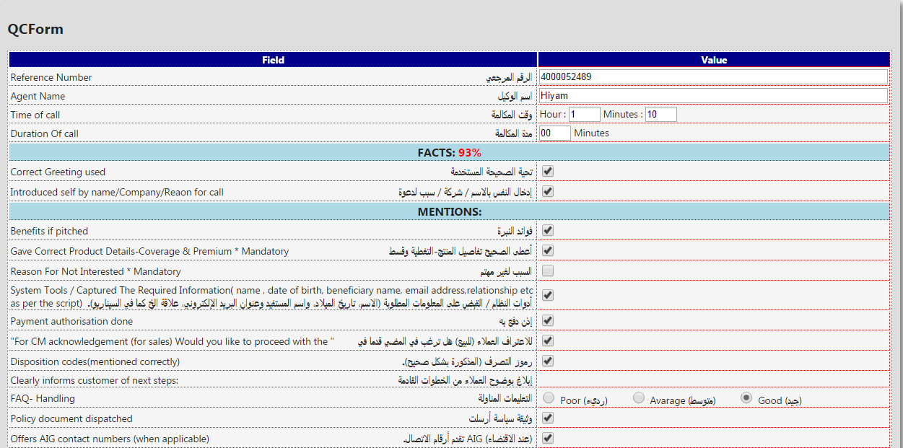
Quality Assurance Module

Slide 23
Sales Support Services
Experienced team of field operatives
Smart & young talented individuals
Building relationships
Servicing the Customers
Deliver what the customer needs based on understanding them

Slide 24
Promotional Campaign
Kiosks at shopping malls & supermarkets
Pre-qualification by promoters
Data acquisition and capture
Driving Awareness and brand image
Smart promoters representing the brand establishing direct connection with consumers

Slide 25
2. CRM
Ralph Browning, Director Loyalty
Notes:
© Copyright Showeet.com – Free PowerPoint Templates

Slide 26
Services
Customer Engagement
Loyalty/CRM RFP
Overall strategy, customer value proposition development, customer experience design & implementation, customer comm., customer journeys & treatment tracks
Assessment of requirements, development of brief, selection of supplier long list, support engagement of RFP process
Loyalty Program Design
Partnership Development
Core strategy, customer value proposition, communications, operational set up, costing & ROI analysis, system selection, recruitment & training
Development of partner propositions, recruitment of reward partners, third party points sale, Partner offers & services, recruitment & contacting
Program Health Check
Optimizing ROI
Operational efficiency, communications effectiveness, investment review, analysis of ROI, program enhancement proposal, team training & mentoring
Costing review, rewards investment and perceived customer value vs. cost, demonstrating reduced churn, and increased share of customer.
Notes:
© Copyright Showeet.com – Free PowerPoint Templates

Slide 27
Industry experience
Retail
Airlines
Loyalty program design for opticians, pharmacy, department stores, jewelers, toy stores, fashion
Customer communication strategies Technology selection, participation in coalition evaluation.
FFP design, LCC design strategies, partner recruitment & point sales.
08
01
Finance
Restaurants
Credit card loyalty program, design and implementation, health check optimization, bank program design, reward partner recruitment, communications planning & ROI effectiveness analysis.
02
Casual & fine dining, program design technology selection
07
Insurance
03
Hospitality
Churn reduction strategies, customer engagement activity, cross selling customer journeys.
06
Strategic design for hospitality groups, hotel program health check
05
04
Packaged goods
Entertainment
Rewards for purchase strategies, promotional concept development, digital engagement activity
Shopping mall leisure facilities program design, family leisure centers customer engagement strategies.
Notes:
© Copyright Showeet.com – Free PowerPoint Templates

Slide 28
3. IT Solutions
A. Venkatraman, Vice President, IT Services
Notes:
© Copyright Showeet.com – Free PowerPoint Templates

Slide 29
IT Solutions
1
Business Intelligence
E signature
IT services
3
2
Services across BI, GRC, E Sign & Mobile security solutions & adding more
GRC
Mobile security
4
Notes:
© Copyright Showeet.com – Free PowerPoint Templates

Slide 30
Business Intelligence
Qlik
Microstrategy
BI Software
Enterprise Analytics Platform
Qlik delivers Business Intelligence software for data visualization, guided analytics, embedded analytics and reporting to over 40000 customers worldwide
MicroStrategy is an easy-to-use enterprise analytics platform that delivers dashboards, visualizations, mobile apps, and more to thousands

Slide 31
MetricStream, comprehensive GRC solution
Policy & Document Management
IT Risk Management
GRC Intelligence ® Content
Enterprise Risk Management
IT Compliance
Operational Risk Management
Threat & Vulnerability
Language Pac
Vendor Risk Management
Integrations
SOX Compliance
Compliance Management
Business Continuity Management
Reg. Change Management
Supplier Quality Audit
Internal Audit
Inspections Management
Operational Audit
NCM & CAPA Management
Case Management
Incident Management
Training & Advisory
Mobile
Third-party Management
Conflict Minerals Management

Slide 32
Zimperium, mobile security solution
Investors
Funded by Warburg Pincus, Sierra Ventures, Telstra and Oxygen
Mobile Security
01
02
03
04
05
Awards
Revolutionary enterprise mobile security solution.
2016 Most Innovative Cyber Security Company – CEA
2016 Best in Breed for Mobile Endpoint -- CDM
2016 Most Disruptive Technology – Telecom Council
2015 Awesome Product of the Year – Info Security
2015 Best of the Show Award – InterOp
2013 Start-up of the year -- KPMG
The solution
Leadership
Behavioral analytics threat detection engine, based on machine learning algorithms, transforms mobile devices from a threat to an advantage
Leading mobile security researchers. Established the ZHA comprised of 30+ leading MNOs, OEMs, App Developers
.
Notes:
© Copyright Showeet.com – Free PowerPoint Templates

Slide 33
4. Information management service
Murtaza Hussain, Business Manager, IMS
Notes:
© Copyright Showeet.com – Free PowerPoint Templates

Slide 34
Enterprise content management ( ECM)
Ensure Compliance
Charting & Reporting Tools
Helps maintain order when structure becomes too big
Enterprise content management
Workflow & Process Automation
Provides Structure out of chaos
Core features
Role Based User Portals
Enable Document anywhere
Federated Identity for Enterprise
Notes:
© Copyright Showeet.com – Free PowerPoint Templates

Slide 35
Business Process Management

Enables companies to model, deploy and manage mission-critical business processes
Span multiple enterprise applications, corporate departments, and business partners.
Cost efficiencies, agility, compliance and better customer service.
Continuously improve business processes.
Reduces time-to-market for changes in business processes.

Account Opening and Maintenance
Account Payable
Call Detail Record Management
Trade finance
Features
Key solutions
Notes:
© Copyright Showeet.com – Free PowerPoint Templates

Slide 36
Contd.
DOCUMENT IMAGING
Converting physical documents into digital form
ASSET MANAGEMENT
Asset management software
Asset lifecycle management
Asset Audit
Asset register buildup

Slide 37
5. Digital Marketing
Deepak Chandrasekharan, GM – Marketing & Comm.
Notes:
© Copyright Showeet.com – Free PowerPoint Templates

Slide 38
Possibilities
Engagement Bot
Bot
Building engagement in-store
Smart video analytics solution
Video Analytics
A smart video analytics solution that provides insights around in-store shopper traffic pattern.
In-app mobile advertising
Mobile advertising
We have a platform that can deliver advertising in-app within a particular geo location layering with other filters.
Notes:
© Copyright Showeet.com – Free PowerPoint Templates

Slide 39
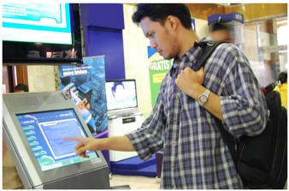
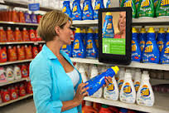
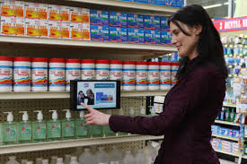
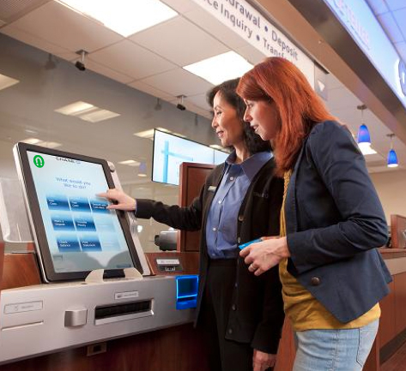
Building engagement at the store using bots
Increase Loyalty Sign-ups
Influence Buying decisions in Real-time
Personalized information based on Customer Choices
Collect and Measure
Feedback instantly

Slide 40
Contd.
Effective store management
Campaign across categories
Call To action Communication, along with Branding content
.
Target focused campaigns
Quickly setup a Campaign
Reach Qualitative TG
Track the engagement
.
Real time insights
Compare effectiveness of communication in different category
Live Dashboard
In store analytics
Notes:
© Copyright Showeet.com – Free PowerPoint Templates

Slide 41
Smart video analytics solution
# Brick & Mortar will have to understand shopping behavior to compete with online
…and helps track intelligent KPIs that go beyond conversions

Slide 42
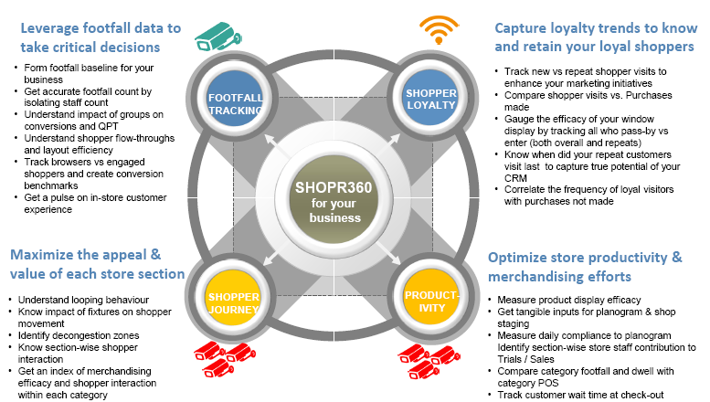
Translates store traffic patterns into tangible business decisions

Slide 43
In–app mobile advertising
1
2
3
Geo location
Age profile
Gender
specific point, street, city, region, country
Age profile bands
Male or female
4
5
6
Keyboard language
Category of apps.
OS & Type of device
English, Arabic
Games / education / tourism / sports / business / fashion
iOS, Android, Windows
We have a platform that can deliver in-app advertising on mobile devices using different parameters within a particular geo location
Notes:
© Copyright Showeet.com – Free PowerPoint Templates

Slide 44
Case study
1
3
The Challenge
Campaign details
Low uptake of dinner buffet in Jan 17 in one of their restaurant properties
Prospects were directed to the group booking page.
2
4
The Tactic
Campaign performance
To position ads to prospects in catchment areas
Lift of 30% achieved
Notes:
© Copyright Showeet.com – Free PowerPoint Templates

Slide 45
Other discussions
01
Chat bots
AI/IOT
02
03
VR
04
High end Website
05
Regular web services
Notes:
© Copyright Showeet.com – Free PowerPoint Templates

Slide 46
Our Clients

Slide 47
Thank you
Notes:
© Copyright Showeet.com – Free PowerPoint Templates

