Slide 1
Contact Center Capabilities
September 2013

Slide 2
About Data Direct
Established in 2002 as a Limited Liability Company (LLC)
Chairman and Managing Director, Mr. Rajiv Dalmia
100 plus employees
Head office in Dubai Media City, Dubai in UAE.
3000 Sq. ft. operation center in central Dubai, UAE
100 workstations contact center
Online and offline fulfillment / mail room / broadcast services
Loyalty program development & management
CRM and data analytics center
Archiving Solution, Records Management, ECM and BPM technologies
Consultancy on resource time and process optimization
Implementation of cost and time effective business processes

Slide 3
Data Direct Business & Services
1. Contact Center
ACD routing
2. CRM & Loyalty
Proprietary loyalty engine
Acquisition and retention
3. Information Management
Records Management
Document Imaging
IVR & CTI
Auto Dialers
Email & digital marketing
Enterprise software solution
Outsourcing services
Direct marketing & fulfillment
PRI lines
Payment gateway
Voice recordings
Lead generation
100 seats

Slide 4
Contact Center

Slide 5
Our learnings in last 12 years
Data security and confidentiality
Dedicated Network, Firewall, Secured access, Surveillance
Robust telephony solutions
Auto Dialer, CTI, ACD, IVR, Voice recordings, PRI lines
CRM /Cross sell & Up sell strategies
Designing acquisition campaigns, Payment gateway
Audits
Banks, Insurance companies, Internal
HR
Smart and confident talent resource
Incentive plan, Continuous feedback & training
Reporting
Product performance
Resource performance
Data list performance
Daily, weekly & monthly modules

Slide 6
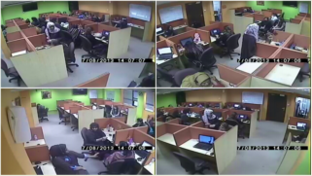
Security, confidentiality & business processes
Process
driven
HR
Security
Established
Process
Control
Screening tests
Reference checks
Soft skills training
Product training
Documentation
Fingerprint access to facility
Cameras for online monitoring
Paperless environment
Documentary controls e.g. NDAs
Chain of command
SLA
QC
Dedicated network
Procedure manuals
Internal audits
External audits

Slide 7
Contact centre Infrastructure
Contact Center
Installed Capacity
Advanced Technology
Multilingual Staff
Experienced Professionals
Installed capacity 100 Seats
Scalable to 200 seats
Business Management
CRM Development
System Integration
Quality Control
Auto dialer
ACD
IVR
Call recording
Live monitoring
Customized CRM
English
Arabic
Hindi/Urdu
Indian subcontinent
Tagalog

Slide 8
Contact Center revenue generation
HR & Training
Technology
Performance & Reporting
Hiring experience talent
PRI lines to manage multiple campaigns
Set achievement targets
Providing legal identity
IT platforms to support sales team to get maximum result
Verification of Lead through QC
Incentives & motivation
Integrate external leads with contact center server such as SMS, SEM etc
Daily performance reports
Regular training & feedback
Automated process for production data upload

Slide 9
Acquisition Strategies through Contact Center

Slide 10
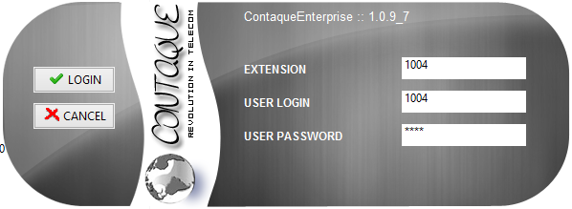
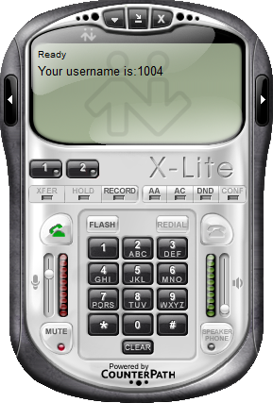
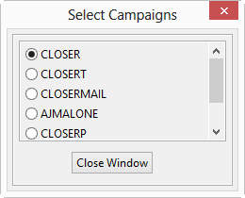
User Interface
Login based interface to track contact centre activity

Slide 11
Skills based ACD

Slide 12
Agent Idle screen

Slide 13
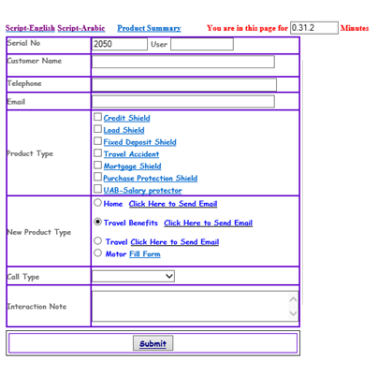
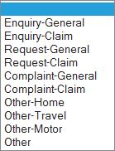
Customized CRM
Skill based
Customer Number

Slide 14
Admin Module

Slide 15
Campaign Monitoring

Slide 16
Campaign Monitoring

Slide 17
Campaign Reporting

Slide 18
Disposition Report

Slide 19
Agent Detailed Performance Report

Slide 20
Abandon Report - Missed calls
Need to have additional agents

Slide 21
Abandon IVR Report (Customer disconnected before talking with agent)

Slide 22
Manage Users & Skill sets

Slide 23
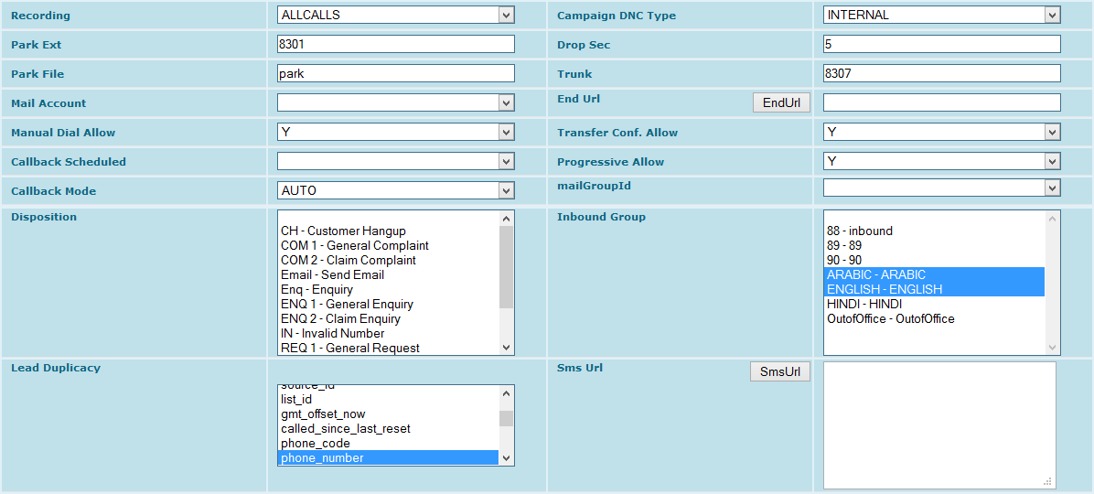
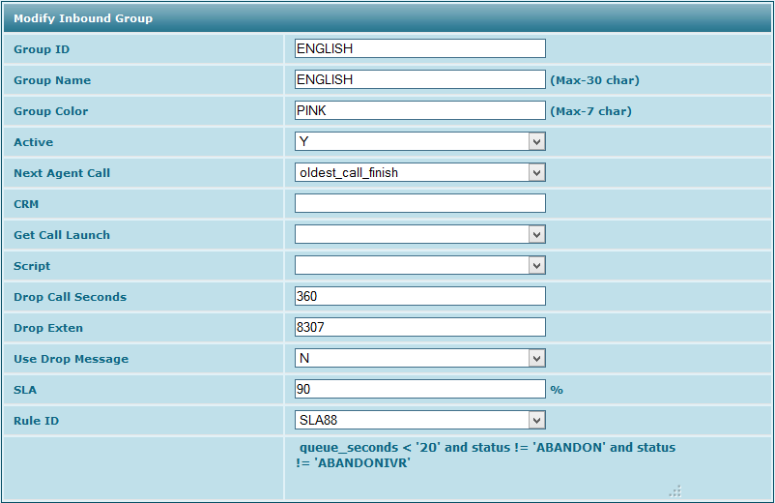
Campaign Management

Slide 24
Monthly reporting
Record Status |  | Summary (MTD)
Total Records Uploaded |  | 50,708
Dialed |  | 40,787
Head Counts |  | 7
UNIQUE RECORDS Dialed Per Agent Per Day |  | 139
Records Available To Dial |  | 9,921
Total Records Connected |  | 20,427
Right Party Contact |  | 18,198
Call Back Before Presentation |  | 8,850
Call Back After Presentation |  | 443
Total Call Backs |  | 9,293
Not Interested Before Presentation |  | 7,265
Do Not Call |  | 179
Not Interested After Presentation |  | 1,307
Total Not Interested |  | 8,751
Total Presentations Made( Total Responses) |  | 1,904
Total Sales |  | 154
Annual Premium |  | 41,584
QC Failed |  | -
QC Approved |  | 154
QC Pending |  | -
Response Rate |  | 8%
Net Pull |  | 0.4%
Wrong Numbers |  | 2,229
Not Contactable |  | 22,589
Contactability |  | 45%

Slide 25
Training Policy
Data Direct recognizes that training is a key to running a successful contact center operation and as such training requirements are given sufficient importance.
Basic customer Service Training
Communication
Expressive skills
Listening skills
6 Cs of communication
Active listening
Why Active listening is important?
What happens if we are not listening actively
Four C's for Taking Good Care of Your Customers
‘On call’ ethics
Advance customer Service Training
Identifying customers and their expectations
Positive steps to excellent customer service
The importance of communication in the service delivery process
Projecting a professional first impression
Making the most of your voice
Building rapport
Telephone etiquettes
Active listening and questioning skills
Tips for effective call handling
Handling complaints and difficult customers
Closing customer interactions positively

Slide 26
Contact Center Case study
Multinational Insurance Company
Challenge:
First outsourced direct sales unit to promote insurance products
Manage compliance and data security as per banks/financial institutes standard
Target driven process to generate maximum revenue from the unit
Solution:
Dedicated Network, Firewall, Secured access, Surveillance
Robust telephony solutions
Auto Dialer, CTI, ACD, IVR, Voice recordings, PRI lines
CRM /Cross sell & Up sell strategies
Designing acquisition campaigns, Payment gateway
Regular Audits & checking
HR
Smart and confident talent resource
Incentive plan, Continuous feedback & training
Reporting
Results:
First year achievement of 400% against the cost spent in year
In spite of financial crisis, second year achievement is 300% against the cost spent
Business increased by 25% in 3rd year

Slide 27
Other Services
Data sourcing & capturing
Data Rental
SMS Management
Email Management
Digital
Production
Direct mailing services
Contact Centre
Loyalty Program Development
Data Analysis & warehousing
Data Entry
Directories Purchases
Program Strategy
Acquisition
Retention
Usage
Technology
Fulfillment
Partnerships
Business profiles
Business Executive Profiles
Demographic segmentation
Customer service
Direct Sales
Lead generation
Survey & brand awareness
RSVP
Data Updation
LIFT: Increase value through plan upsells
SHIFT: Offer new services and products
RETENTION: Keep on the network for longer
Website & Microsite
Social Media
Mobile apps
SEO & SEM
Personalized letter& Labels
Mail Management
Postal & courier despatch
Response Management
Marketing Material Storage
HTML Development
Emailer broadcasting
CTR reporting
Sent
Opened
Clicked
Unsubscribed
Short code rental
Inbound SMS management
Outbound SMS management
Promotions & offers management

Slide 28
Our clients

Slide 29
Thank you
Data Direct FZ LLC PO Box 502082 Dubai Media City Dubai, UAE Phone: +971 4 390 2580

