Slide 1
Data Direct Group
Credentials
Notes:
© Copyright Showeet.com – Free PowerPoint Templates

Slide 2
Strategic Partnership with MOHRE
Data Direct Group of Companies is pleased to inform you of our strategic partnership with Ministry Of Human Resources And Emiratisation to accelerate the Tawteen initiative.
As part of Tawteen initiative and UAE Vision 2021, Data Direct Group of Companies are setting up a Center of Excellence in Fujairah to empower Emiratis and deliver efficient and effective business services in the back office & outsourcing space.
In collaboration with Ministry Of Human Resources And Emiratisation, our Center of Excellence is aimed at providing top quality services at competitive prices and achieve the national agenda of UAE Vision 2021.

Slide 3
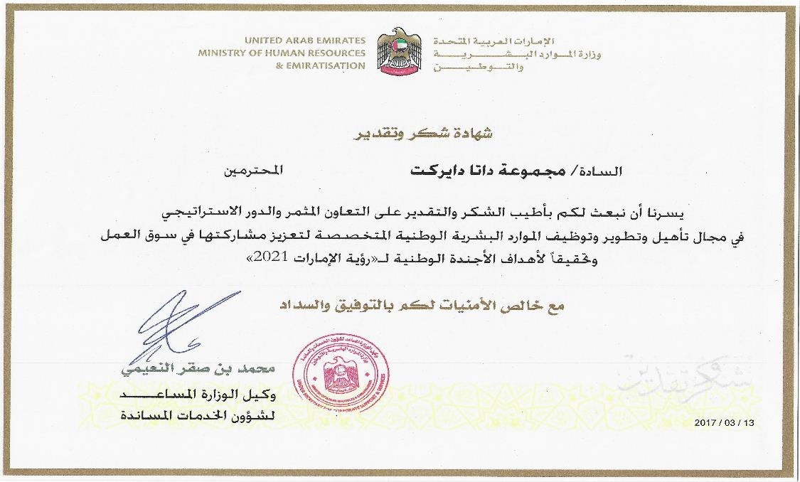
COPYRIGHT © 2019 DATA DIRECT ALL RIGHTS RESERVED

Slide 4
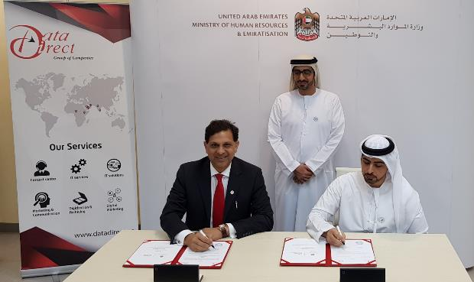
Press Release
COPYRIGHT © 2019 DATA DIRECT ALL RIGHTS RESERVED

Slide 5
About Data Direct
The Organization
ISO 9001:2015 Certified Company
Established in 2002 as a Limited Liability Company (LLC)
Rajiv Dalmia, Chairman and Managing Director (MIB – Australia)
Data Direct Group Companies:
HQ: Dubai Media City, UAE. Operations Unit in Dubai : Direct Outsourcing Services LLC - 150 workstations
Onsite contact center for client in Oman (2014) : Century Data Systems LLC – 50 workstations
On site contact center for client in KSA (2015) : Data Direct Saudi Arabia – 100 workstations
Operations Unit in Sri Lanka (2016) : Data Direct South Asia Pvt. Ltd. - 25 workstations
Presence in Nigeria (2017) : Data Swift Africa Ltd
Offshore Analytics Team from India
Our Offerings
Contact Centre Services ; Loyalty program development & management
Archiving Solution, Records Management, ECM and BPM technologies
COPYRIGHT © 2019 DATA DIRECT ALL RIGHTS RESERVED

Slide 6
Service Lines
CC
ITS
CRM
Digital
Contact center
IT services & solutions
Loyalty services
Mobile & web
24/7 operations, Inbound & Outbound Service, Telesales & customer services, Multiple languages support
Enterprise Content Mgmt., Business Process Mgmt., Document Imagine, Asset Tagging, IT Outsourcing & Acquisition, Dashboard solution, BI, E sign, GRC, Mobile security
Customer engagement strategy, loyalty program design, Program health check evaluation, Optimizing ROI, Loyalty/ CRM services
Mobile advertising, High end Web site & mobile app, engagement bot, in-store traffic flow
COPYRIGHT © 2019 DATA DIRECT ALL RIGHTS RESERVED
Notes:
© Copyright Showeet.com – Free PowerPoint Templates

Slide 7
Contact center
COPYRIGHT © 2019 DATA DIRECT ALL RIGHTS RESERVED
Notes:
© Copyright Showeet.com – Free PowerPoint Templates

Slide 8
Data Direct’s Knowledge Bank
Experienced Management
Wide Range of Clients
Technology & Infrastructure
Turn Around Time
Security Standards
Backup & Disaster Recovery
Process Driven Approach
High LTV
300+ Staff
COPYRIGHT © 2019 DATA DIRECT ALL RIGHTS RESERVED

Slide 9
Our Regional Experience - Overview
Employment Strategy
Offering jobs to the citizens of the country in this region using innovative sourcing methods
100% compliant with nationalization policies in Oman and Saudi Arabia
Simplification & Automation
We have simplified various time-consuming tasks by automating our back office processes ranging from sourcing candidates to managing performance on behalf of our clients
Proven Results
Outsourcing is a proven way to transform departments without adding additional infrastructure, headcount, or cost.
We have experienced that the citizens of their respective countries have performed better when provided the correct employment platform, repetitive training and continuous support
COPYRIGHT © 2019 DATA DIRECT ALL RIGHTS RESERVED

Slide 10
Our Clients – BFSI
COPYRIGHT © 2019 DATA DIRECT ALL RIGHTS RESERVED

Slide 11
Our Clients – Government
 | Fujairah Finance Department
 | Engineer Office
COPYRIGHT © 2019 DATA DIRECT ALL RIGHTS RESERVED

Slide 12
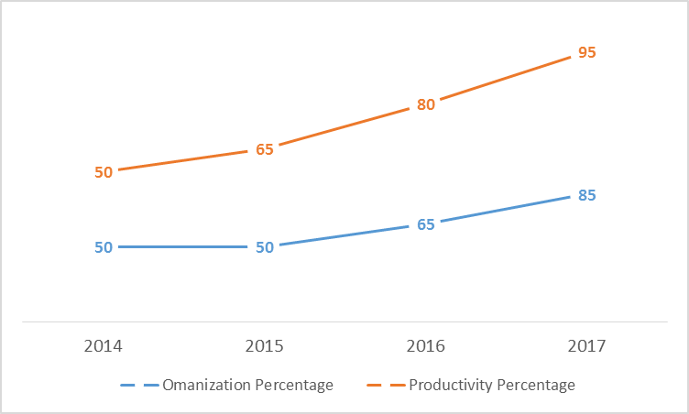
Experience in Sultanate of Oman
Successfully managing business with 85% Omanis from last 4 years
Started with small team in year 2014 and ramp up to 300% capacity
The performance and productivity have continued to grow month on month
Employment to Omani Nationals has allowed to execute the projects in native language and dialects
It has also helped to reduce the cost of employment of expatriate employees
The employees gender ratio helps to managed contact centre process seamlessly
COPYRIGHT © 2019 DATA DIRECT ALL RIGHTS RESERVED

Slide 13
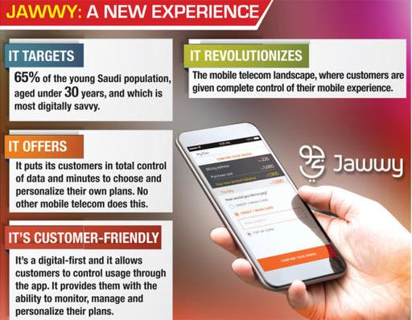
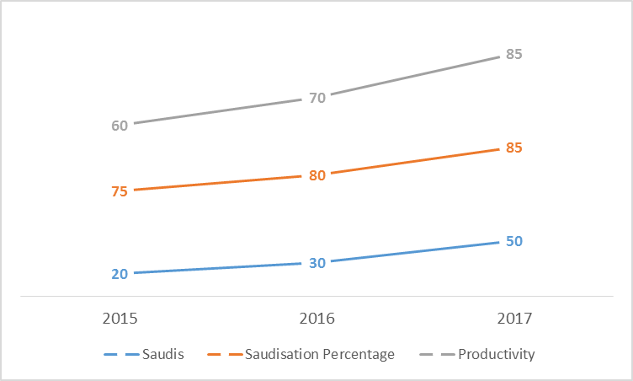
Experience in Kingdom of Saudi Arabia
Successfully managing operations with 80% Saudi nationals from last 3 years
Started with small team in year 2015 and ramp up to 250% capacity
Many of candidates had depicted a willingness to work with Data Direct Saudi Arabia
Provided employment to Graduate and under Graduate Saudi nationals to exhibit the abilities in digital world
The performance and productivity have continued to grow month on month
Employment to Saudi nationals has allowed to execute the projects in quick time period
COPYRIGHT © 2019 DATA DIRECT ALL RIGHTS RESERVED

Slide 14
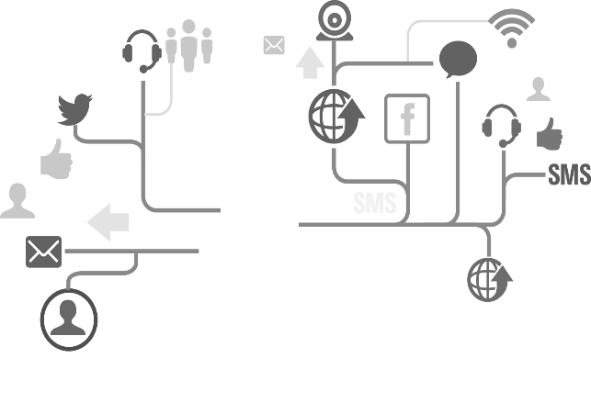
Our Key Services
01
04
Telesales
Customer support
Generating a sale & closing it as well telephone/online.
Inbound & Outbound support processes
02
05
Demand Generation
Customer Profiling
Qualifying a lead & passing to Channel/ Sales team
Enhance profile via calling
03
06
Market Surveys
RSVP
CATI led & basic surveys
Typically events
COPYRIGHT © 2019 DATA DIRECT ALL RIGHTS RESERVED
Notes:
© Copyright Showeet.com – Free PowerPoint Templates

Slide 15
Knowledge Management
We offers ‘Train The Trainer’ (TTT) approach to our clients
A set of individuals from our team will get trained and certified by Client’s trainers
These certified trainers then will train the subsequent batches for the program
The entire training will be divided into two parts; Pre-process training & Process training
The pre-process training will include soft-skill, customer service, telephone etiquettes, assertiveness and objection handling
The process training includes understanding the CRM, process work flows, SOPS, etc.
Keeping in view the dynamic nature of our client’s business where changes and updates are essential to the business, we also believe to have a monthly refresher training
A training manual would be created in conjunction with inputs from Data Direct & clients which will be updated on an on-going basis
We also propose to create a list of frequently asked questions (FAQ) and store it for future training purpose
COPYRIGHT © 2019 DATA DIRECT ALL RIGHTS RESERVED

Slide 16
Contact Centre - Team Structure
Managing Director
Business Manager
CFO
Operations Manager
Process Expert
Team Leaders 1
DBA & IT Support 1
Quality Controller 1
Agent
Agent
Agent
Agent
Account Manager 2
Team Leaders 2
DBA & IT support 2
Quality Controller 2
Agent
Agent
Agent
Agent
Account Manager 1
COPYRIGHT © 2019 DATA DIRECT ALL RIGHTS RESERVED

Slide 17
Reporting Dashboard
COPYRIGHT © 2019 DATA DIRECT ALL RIGHTS RESERVED

Slide 18
Information management service
COPYRIGHT © 2019 DATA DIRECT ALL RIGHTS RESERVED
Notes:
© Copyright Showeet.com – Free PowerPoint Templates

Slide 19
Enterprise content management ( ECM)
Ensure Compliance
Charting & Reporting Tools
Helps maintain order when structure becomes too big
Enterprise content management
Workflow & Process Automation
Provides Structure out of chaos
Core features
Role Based User Portals
Enable Document anywhere
Federated Identity for Enterprise
COPYRIGHT © 2019 DATA DIRECT ALL RIGHTS RESERVED
Notes:
© Copyright Showeet.com – Free PowerPoint Templates

Slide 20
Business Process Management

Enables companies to model, deploy and manage mission-critical business processes
Span multiple enterprise applications, corporate departments, and business partners.
Cost efficiencies, agility, compliance and better customer service.
Continuously improve business processes.
Reduces time-to-market for changes in business processes.

Account Opening and Maintenance
Account Payable
Call Detail Record Management
Trade finance
Features
Key solutions
COPYRIGHT © 2019 DATA DIRECT ALL RIGHTS RESERVED
Notes:
© Copyright Showeet.com – Free PowerPoint Templates

Slide 21
Contd.
DOCUMENT IMAGING
Converting physical documents into digital form
ASSET MANAGEMENT
Asset management software
Asset lifecycle management
Asset Audit
Asset register buildup
COPYRIGHT © 2019 DATA DIRECT ALL RIGHTS RESERVED

Slide 22
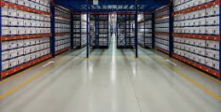
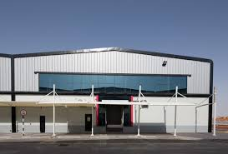
Records Management
Facility located in KIZAD, Abu Dhabi
12,000 Sq. Ft. facility, purposely racked for document storage only
Capacity 150,000 boxes
Temperature and Humidity controlled (installed with AC's)
Security : Highly secure, directly linked to Civil Defense, monitored by CCTV cameras and motion detectors. In addition 24/7 security guards on premise
Safety : Equipped with automatic dry powder fire extinguishers, smoke detectors, 24/7 control panels connected to Abu Dhabi Port
Highly secure media room, fire rated walls and door, holds out fire for 2 hours. Equipped with CCTV and AC 24/7. Storage are in media room is racked, tapes are stored in turtle cases. Individual turtle cases per client
COPYRIGHT © 2019 DATA DIRECT ALL RIGHTS RESERVED

Slide 23
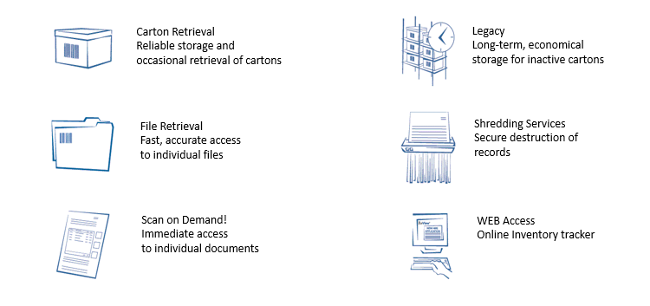
Records Management - Services

Slide 24
IT Solutions
COPYRIGHT © 2019 DATA DIRECT ALL RIGHTS RESERVED
Notes:
© Copyright Showeet.com – Free PowerPoint Templates

Slide 25
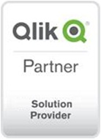
IT Solutions
1
Business Intelligence
E signature
IT services
3
2
Services across BI, GRC, E Sign & Mobile security solutions & adding more
GRC
Mobile security
4
COPYRIGHT © 2019 DATA DIRECT ALL RIGHTS RESERVED
Notes:
© Copyright Showeet.com – Free PowerPoint Templates

Slide 26
Business Intelligence
Qlik
Microstrategy
BI Software
Enterprise Analytics Platform
Qlik delivers Business Intelligence software for data visualization, guided analytics, embedded analytics and reporting to over 40000 customers worldwide
MicroStrategy is an easy-to-use enterprise analytics platform that delivers dashboards, visualizations, mobile apps, and more to thousands
COPYRIGHT © 2019 DATA DIRECT ALL RIGHTS RESERVED

Slide 27
MetricStream, comprehensive GRC solution
Policy & Document Management
IT Risk Management
GRC Intelligence ® Content
Enterprise Risk Management
IT Compliance
Operational Risk Management
Threat & Vulnerability
Language Pac
Vendor Risk Management
Integrations
SOX Compliance
Compliance Management
Business Continuity Management
Reg. Change Management
Supplier Quality Audit
Internal Audit
Inspections Management
Operational Audit
NCM & CAPA Management
Case Management
Incident Management
Training & Advisory
Mobile
Third-party Management
Conflict Minerals Management
COPYRIGHT © 2019 DATA DIRECT ALL RIGHTS RESERVED

Slide 28
Zimperium, mobile security solution
Investors
Funded by Warburg Pincus, Sierra Ventures, Telstra and Oxygen
Mobile Security
01
02
03
04
05
Awards
Revolutionary enterprise mobile security solution.
2016 Most Innovative Cyber Security Company – CEA
2016 Best in Breed for Mobile Endpoint -- CDM
2016 Most Disruptive Technology – Telecom Council
2015 Awesome Product of the Year – Info Security
2015 Best of the Show Award – InterOp
2013 Start-up of the year -- KPMG
The solution
Leadership
Behavioral analytics threat detection engine, based on machine learning algorithms, transforms mobile devices from a threat to an advantage
Leading mobile security researchers. Established the ZHA comprised of 30+ leading MNOs, OEMs, App Developers
.
COPYRIGHT © 2019 DATA DIRECT ALL RIGHTS RESERVED
Notes:
© Copyright Showeet.com – Free PowerPoint Templates

Slide 29
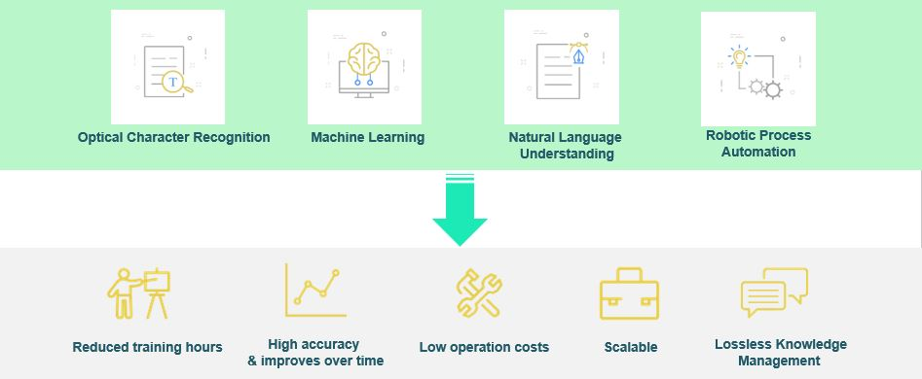
Machine Learning – RPA enabled KYC process automation

Slide 30
Partners and Solutions
Notes:
© Copyright Showeet.com – Free PowerPoint Templates

Slide 31
CRM
COPYRIGHT © 2019 DATA DIRECT ALL RIGHTS RESERVED
Notes:
© Copyright Showeet.com – Free PowerPoint Templates

Slide 32
Services
Customer Engagement
Loyalty/CRM RFP
Overall strategy, customer value proposition development, customer experience design & implementation, customer comm., customer journeys & treatment tracks
Assessment of requirements, development of brief, selection of supplier long list, support engagement of RFP process
Loyalty Program Design
Partnership Development
Core strategy, customer value proposition, communications, operational set up, costing & ROI analysis, system selection, recruitment & training
Development of partner propositions, recruitment of reward partners, third party points sale, Partner offers & services, recruitment & contacting
Program Health Check
Optimizing ROI
Operational efficiency, communications effectiveness, investment review, analysis of ROI, program enhancement proposal, team training & mentoring
Costing review, rewards investment and perceived customer value vs. cost, demonstrating reduced churn, and increased share of customer.
COPYRIGHT © 2019 DATA DIRECT ALL RIGHTS RESERVED
Notes:
© Copyright Showeet.com – Free PowerPoint Templates

Slide 33
Industry experience
Retail
Airlines
Loyalty program design for opticians, pharmacy, department stores, jewelers, toy stores, fashion
Customer communication strategies Technology selection, participation in coalition evaluation.
FFP design, LCC design strategies, partner recruitment & point sales.
08
01
Finance
Restaurants
Credit card loyalty program, design and implementation, health check optimization, bank program design, reward partner recruitment, communications planning & ROI effectiveness analysis.
02
Casual & fine dining, program design technology selection
07
Insurance
03
Hospitality
Churn reduction strategies, customer engagement activity, cross selling customer journeys.
06
Strategic design for hospitality groups, hotel program health check
05
04
Packaged goods
Entertainment
Rewards for purchase strategies, promotional concept development, digital engagement activity
Shopping mall leisure facilities program design, family leisure centers customer engagement strategies.
COPYRIGHT © 2019 DATA DIRECT ALL RIGHTS RESERVED
Notes:
© Copyright Showeet.com – Free PowerPoint Templates

Slide 34
Digital Marketing
COPYRIGHT © 2019 DATA DIRECT ALL RIGHTS RESERVED
Notes:
© Copyright Showeet.com – Free PowerPoint Templates

Slide 35
Possibilities
Engagement Bot
Bot
Building engagement in-store
Smart video analytics solution
Video Analytics
A smart video analytics solution that provides insights around in-store shopper traffic pattern.
In-app mobile advertising
Mobile advertising
We have a platform that can deliver advertising in-app within a particular geo location layering with other filters.
COPYRIGHT © 2019 DATA DIRECT ALL RIGHTS RESERVED
Notes:
© Copyright Showeet.com – Free PowerPoint Templates

Slide 36
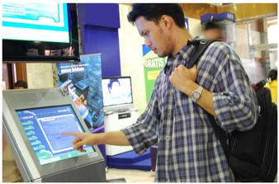
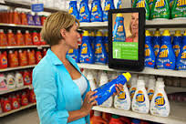
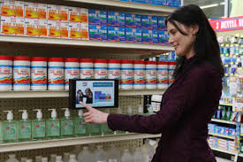
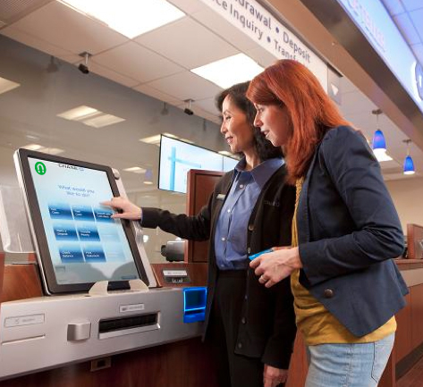
Building engagement at the branch using bots
Increase Loyalty Sign-ups
Influence Buying decisions in Real-time
Personalized information based on Customer Choices
Collect and Measure
Feedback instantly
COPYRIGHT © 2019 DATA DIRECT ALL RIGHTS RESERVED

Slide 37
Contd.
Effective store management
Campaign across categories
Call To action Communication, along with Branding content
.
Target focused campaigns
Quickly setup a Campaign
Reach Qualitative TG
Track the engagement
.
Real time insights
Compare effectiveness of communication in different category
Live Dashboard
In store analytics
COPYRIGHT © 2019 DATA DIRECT ALL RIGHTS RESERVED
Notes:
© Copyright Showeet.com – Free PowerPoint Templates

Slide 38
In–app mobile advertising
1
2
3
Geo location
Age profile
Gender
specific point, street, city, region, country
Age profile bands
Male or female
4
5
6
Keyboard language
Category of apps.
OS & Type of device
English, Arabic
Games / education / tourism / sports / business / fashion
iOS, Android, Windows
We have a platform that can deliver in-app advertising on mobile devices using different parameters within a particular geo location
COPYRIGHT © 2019 DATA DIRECT ALL RIGHTS RESERVED
Notes:
© Copyright Showeet.com – Free PowerPoint Templates

Slide 39
8. Marketing Services
Direct Sales Agency
Notes:
© Copyright Showeet.com – Free PowerPoint Templates

Slide 40
Sales Support Services (DSA)
Experienced team of field operatives
Smart & young talented individuals
Building relationships
Servicing the Customers
Deliver what the customer needs based on understanding them
COPYRIGHT © 2019 DATA DIRECT ALL RIGHTS RESERVED

Slide 41
Promotional Campaign
Kiosks at shopping malls & supermarkets
Pre-qualification by promoters
Data acquisition and capture
Driving Awareness and brand image
Smart promoters representing the brand establishing direct connection with consumers
COPYRIGHT © 2019 DATA DIRECT ALL RIGHTS RESERVED

Slide 42
Thank You

